Slide 1


[DoraHacks Challenge]
Quantum Random Number Generator (QRNG)
Team 3:
Adriel Poo Armas - Maxwell King - Tam Ngoc Bao Bang
SC Quantation, 10th-12th October 2024

Slide 2
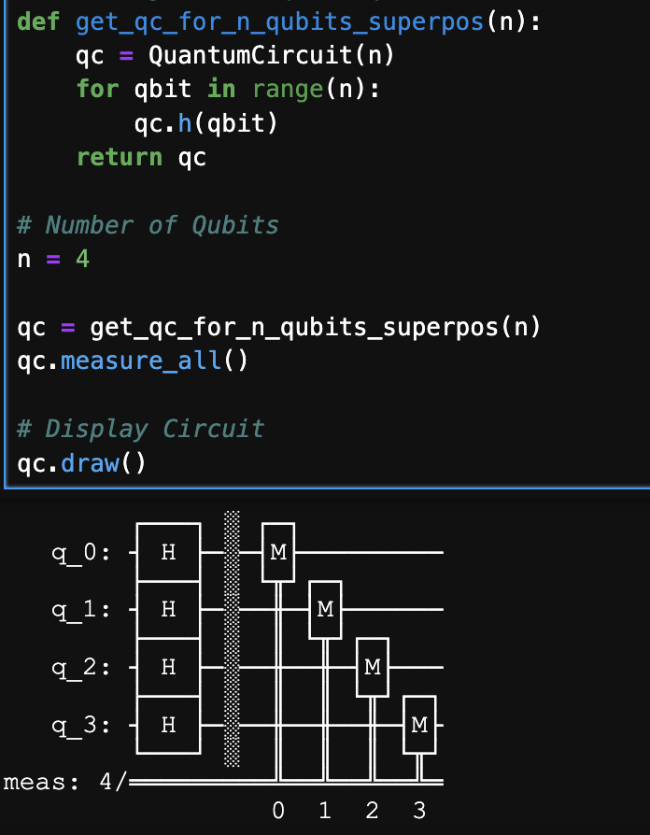
Stage 1 - Implementing a QRNG on IBM QPUs
Since QRNG leverages the inherent unpredictability of quantum mechanics simple quantum circuit of hadamard gates on n qubits creating equal superposition is enough to create a QRNG.
-For simplicity in presenting this problems, we showcase to a circuit with only 4 qubits-
Output data was generated using 30 qubits for simulations and 100 qubits for IBM quantum machines

Slide 3
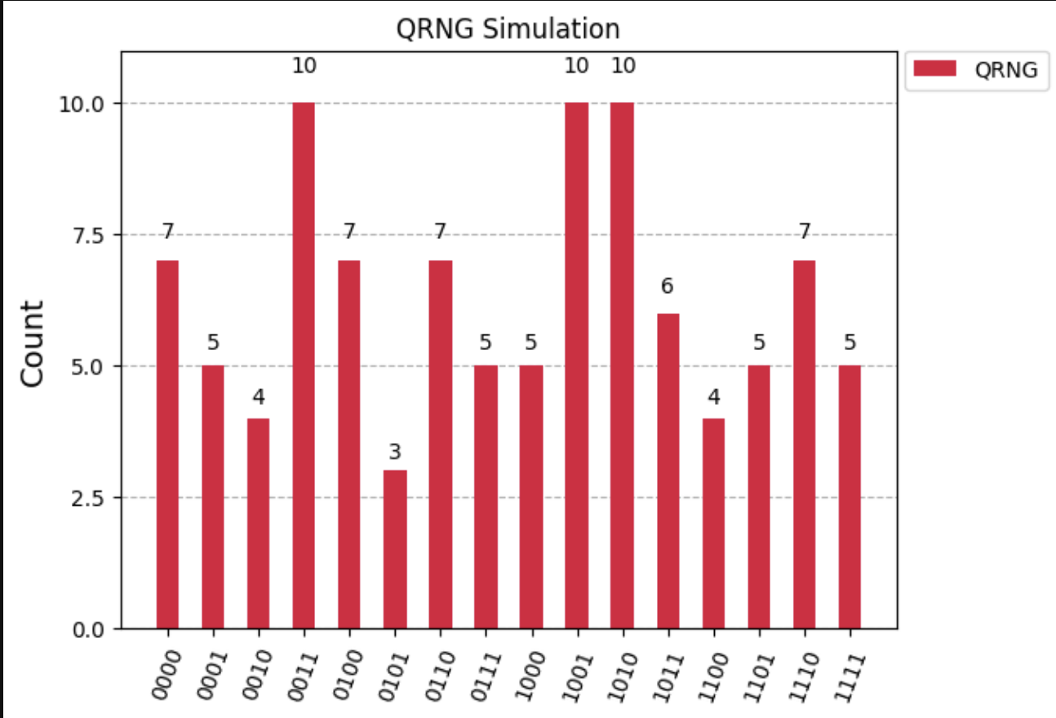
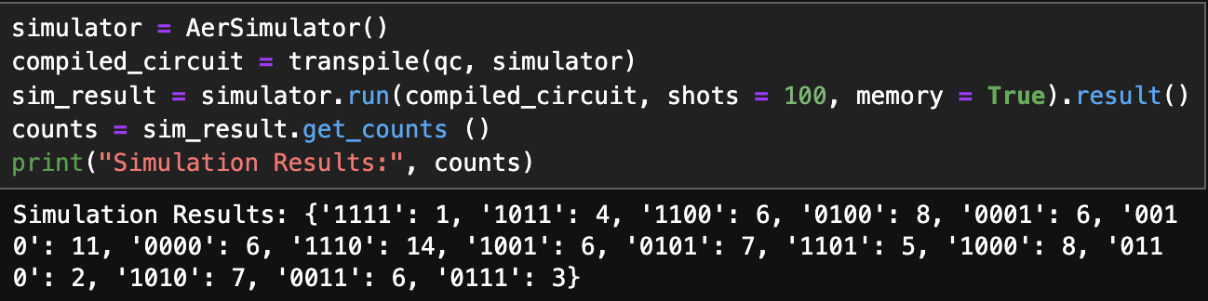
Stage 1 - QRNG Simulator
4 qubits
100 shots
Qiskit AerSimulator

Slide 4
Stage 1 - Implementing a QRNG on IBM QPUs
IBM “Real” Quantum Machine Implementation
IBM Qiskit Runtime
Client Protocols v0.30.0
Using Qiskit SDK & qBraid IBM Protocols v0.8.3

Slide 5
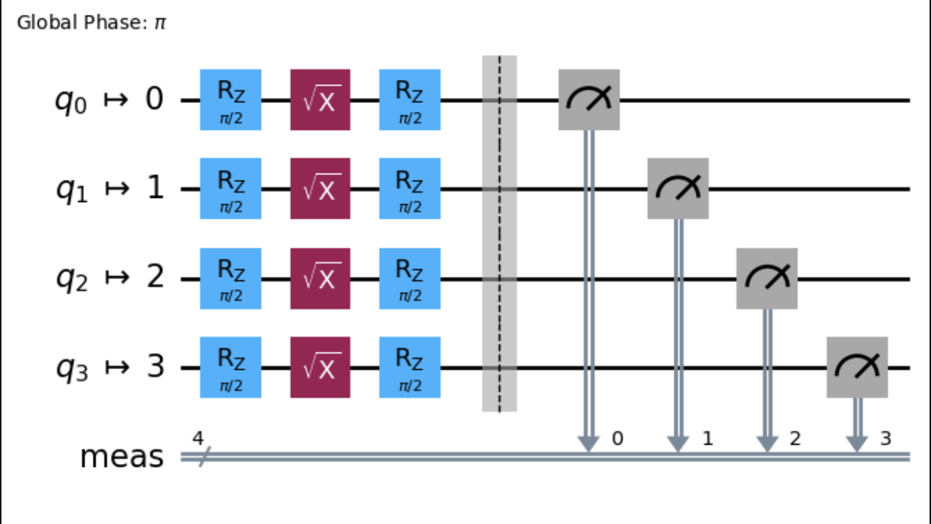
Stage 1 - Implementing a QRNG on IBM QPUs - Qiskit Runtime Client
Use Qiskit RuntimeService with ibm_quantum as your channel and your IBM API token to connect to IBM QPUs.
Transpose your circuit. We used preset pass managers to create an ISA circuit that IBM quantum processors can read.

Slide 6
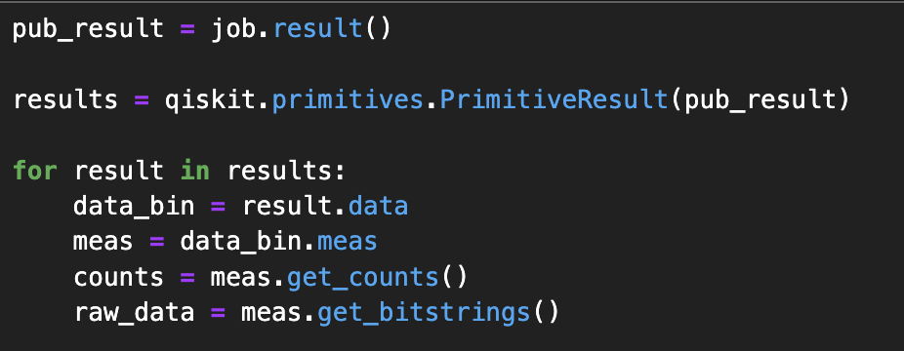
Stage 1 - Implementing a QRNG on IBM QPUs - Qiskit Runtime Client
Submit a job through Sampler V2 by running the transposed quantum circuit with n number of shots/ tries.
When the job is done parse through the PrimitiveResult object to obtain the raw data and count of the submitted job. (You could print/save your job ID in case you want to come back at a later time and then run the result extraction code below. <service>.job(job_id)

Slide 7
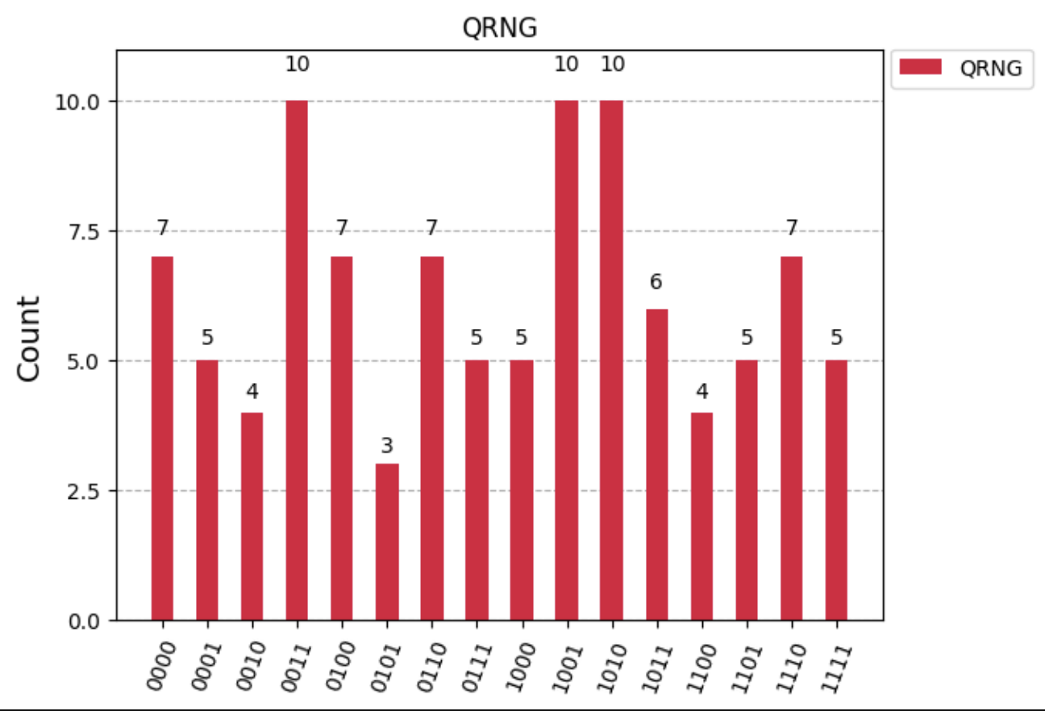
Stage 1 - Implementing a QRNG on IBM QPUs - Qiskit Runtime Client
Visualize the output with a histogram and export the QRNG output to file.

Slide 8
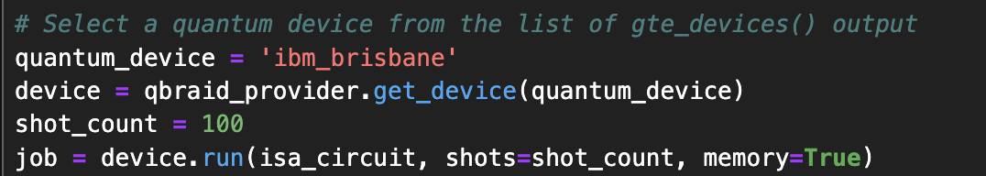
Stage 1 - Implementing a QRNG on IBM QPUs - qBraid
Connect to runtime service - same as before - and transpose your circuit
qbraid_provider = QiskitRuntimeProvider(token=API_KEY, channel='ibm_quantum' )
qbraid_provider.get_devices()

Slide 9
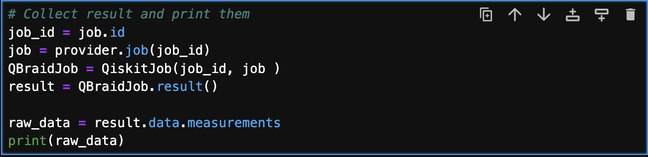
Stage 1 - Implementing a QRNG on IBM QPUs - qBraid
Run job.id if the kernel didn’t reset or pass a string of your saved job id.
Visualize the data (print, histogram…) and save output to external file.

Slide 10
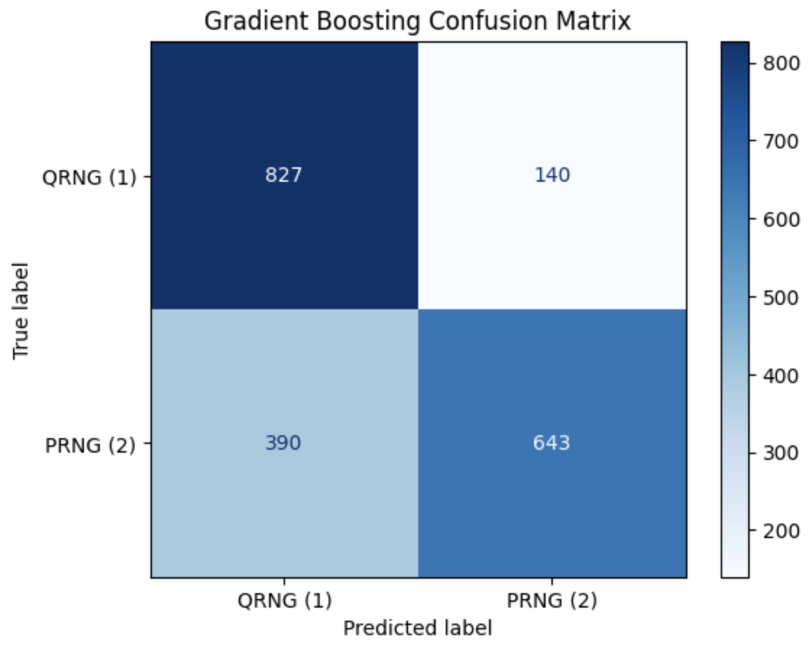
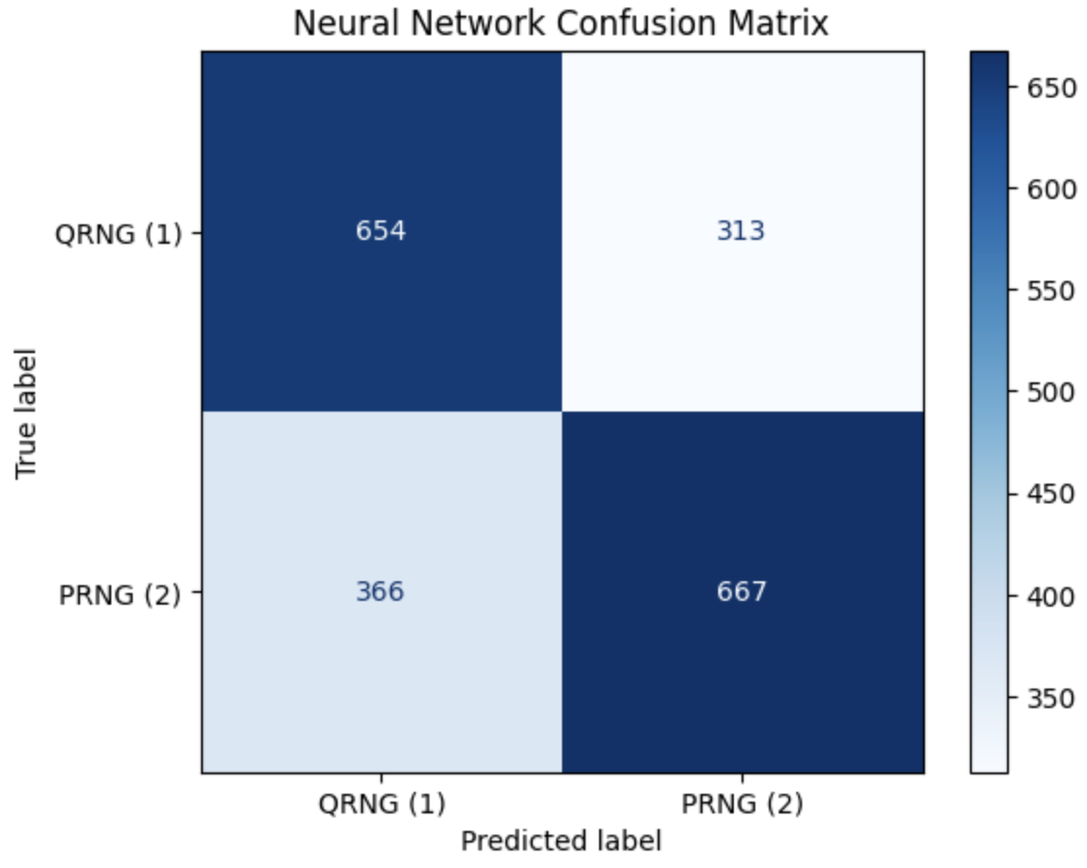
Stage 2 - Achieving High Accuracy with Classification Models
The accuracy of Gradient Boosting is 73.50%, while MLP achieved only 66.05%. The dataset consists of 5,000 samples from QRNG and 5,000 samples from PRNG, with the training set comprising 80% and the test set 20% of the total data.
Confusion matrix of Gradient Boosting and MLP on test set

Slide 11
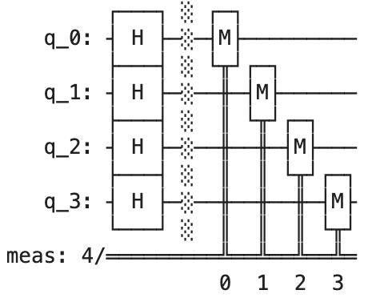
Stage 3 - Characterizing Noise and Fidelity
IBM quantum computers encounter four primary types of noise:
Decoherence
Gate errors
Measurement errors
Crosstalk
For simplicity in presenting this problems, we choose to analyze the effect of decoherence to a circuit with only 4 qubits, as shown below:
Quantum circuit for QRNG.

Slide 12
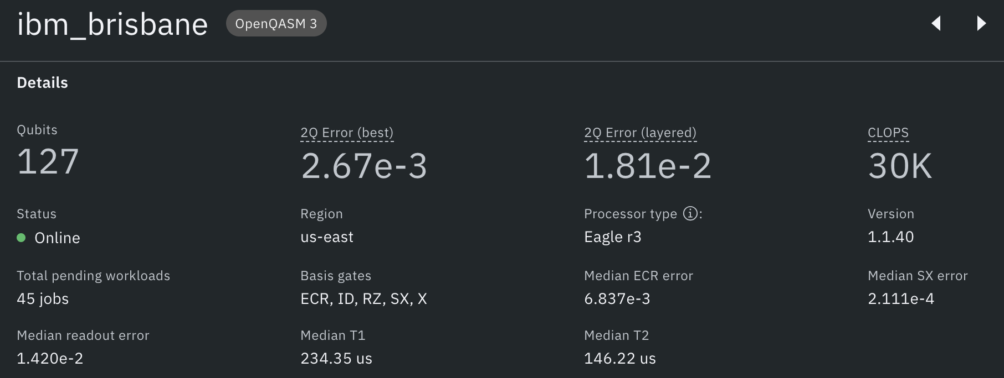
Stage 3 - Characterizing Noise and Fidelity
The simulation based on the average error rates of individual qubits and quantum gates from the 'ibm_brisbane' quantum computer, as shown in the figure, using IBM/Qiskit quantum simulators. Our focus is on T1 and T2.
Computer resources of ibm_brisbane

Slide 13
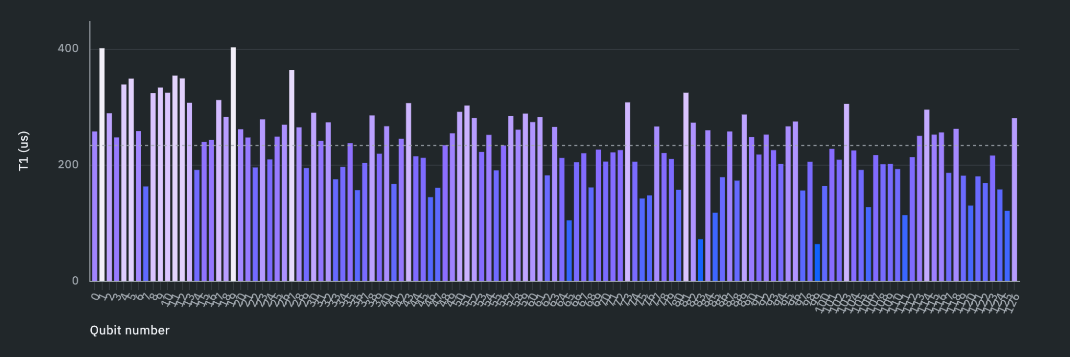
Stage 3 - Characterizing Noise and Fidelity
T1 is the relaxation time, indicating how long a qubit remains in its excited state ( before decaying back to its ground state.
T1 (us) according with different number of qubit onibm_brisbane.

Slide 14
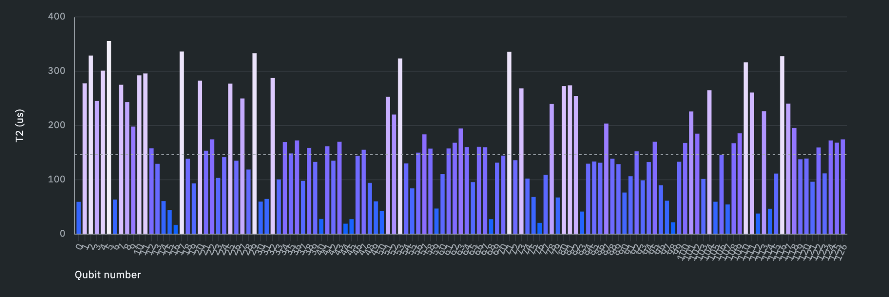
Stage 3 - Characterizing Noise and Fidelity
T2 is the dephasing time, measuring how long a qubit maintains its phase coherence.
T2 (us) according with different number of qubit onibm_brisbane.

Slide 15
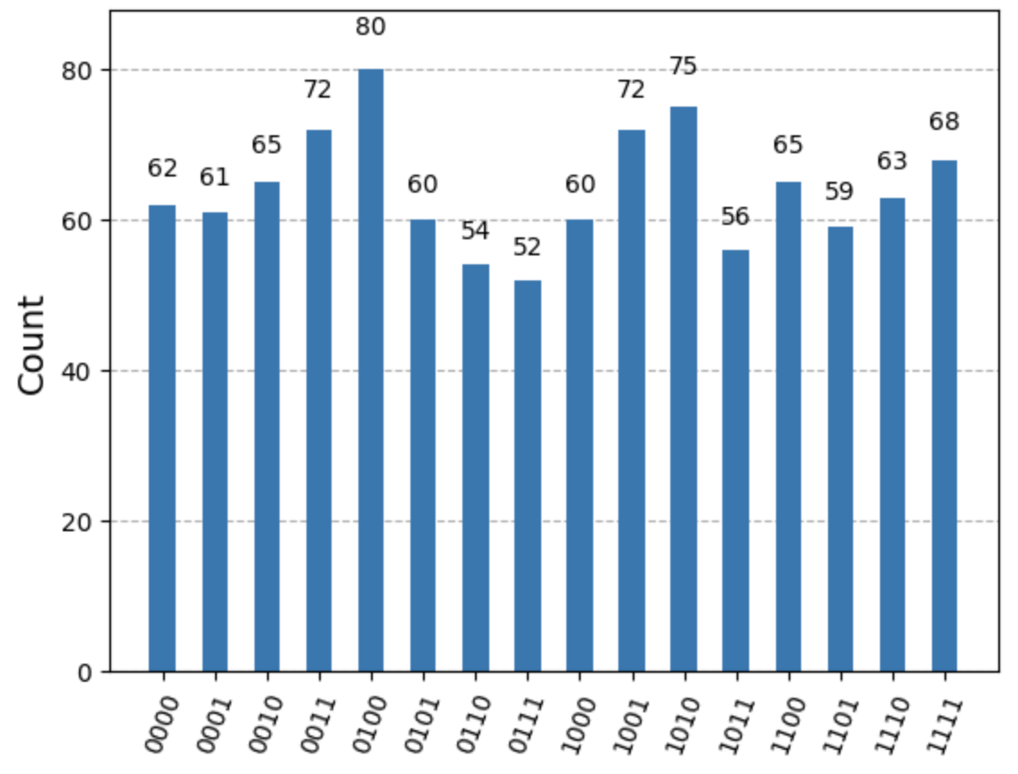
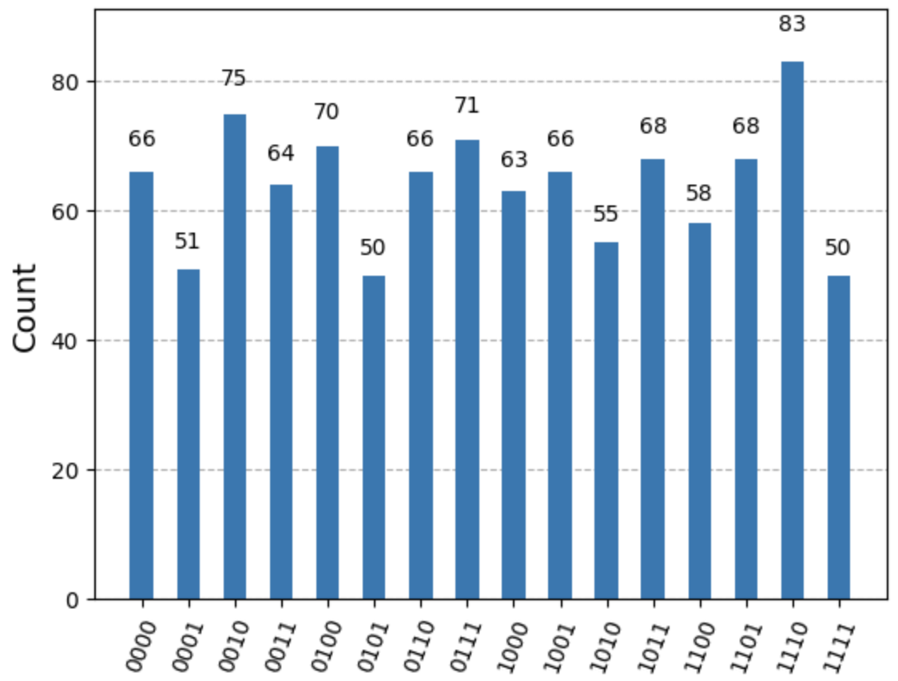
Stage 3 - Characterizing Noise and Fidelity
Run the circuit for 1024 shots on both the ideal quantum simulator and the noisy quantum simulator (median of T1 = 234.35 us and median of T2 = 146.22 us).
Results from the ideal system (left) and the noisy system (right).

Slide 16
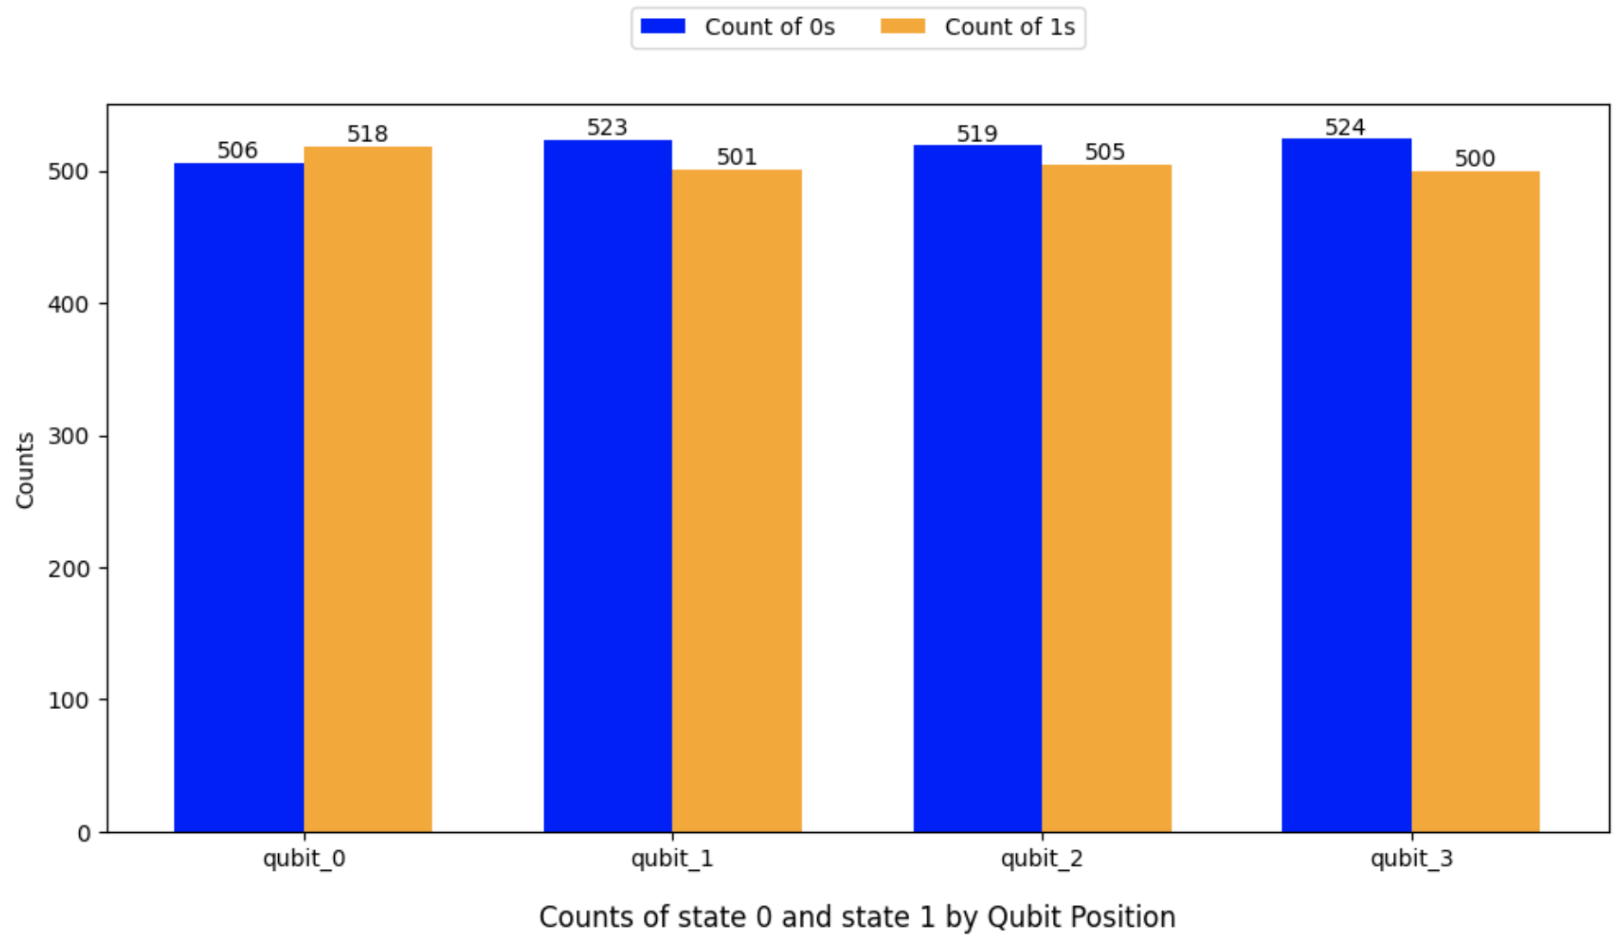
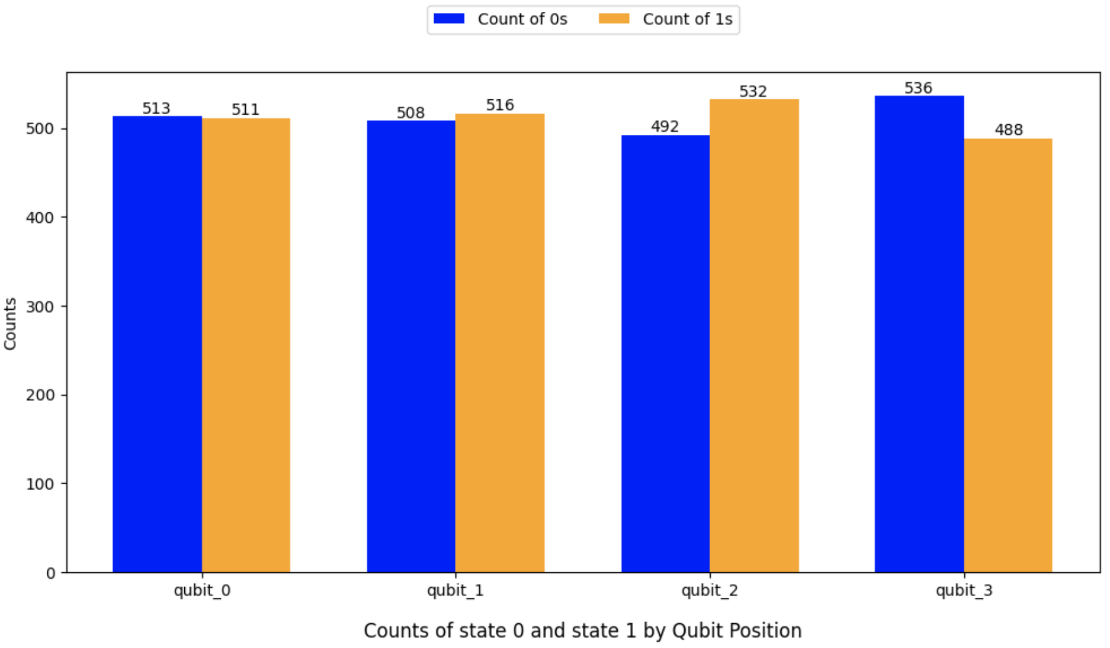
Stage 3 - Characterizing Noise and Fidelity
Counts of state 0 and state 1 by qubit position.
Results from the ideal system (left) and the noisy system (right).

Slide 17
Stage 3 - Characterizing Noise and Fidelity
What happens if we measure after T1?
Measuring after T1 would give insight into the relaxation error, where qubits might decay from the excited state to the ground state, affecting the accuracy of measurement outcomes due to decoherence over time.
What happens if we measure after T2?
Measuring after T2 would capture the impact of dephasing errors, where qubits lose phase coherence. This loss affects superposition states, leading to reduced fidelity in measurement results due to noise and environmental interactions.

Slide 18
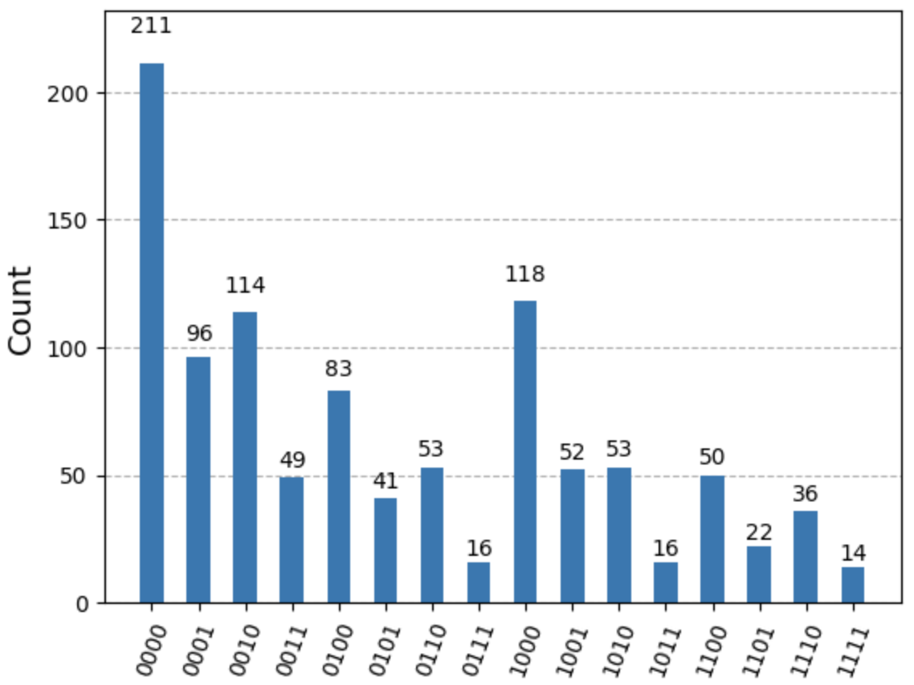
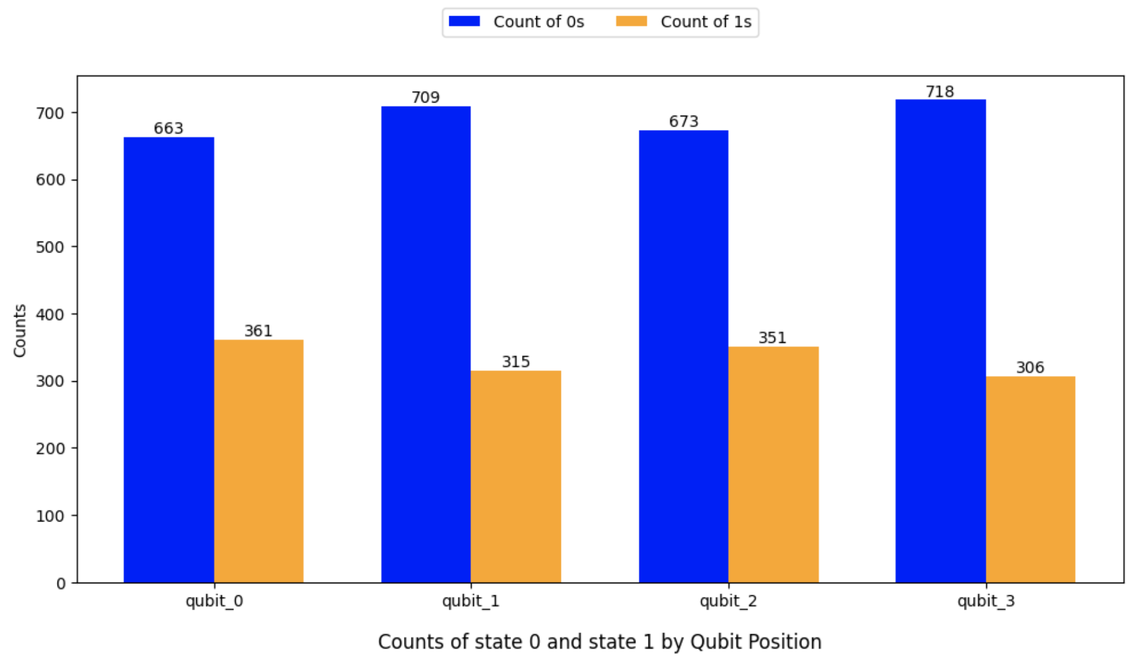
Stage 3 - Characterizing Noise and Fidelity
Run the circuit for 1024 shots on the noisy quantum simulator after reducing the median of T1 to 2.34 us and median of T2 to 1.46 us.
Results from the noisy system after reducing T1 and T2 by 100x.

Slide 19
Stage 3 - Characterizing Noise and Fidelity
Calculating fidelity between quantum states involves comparing an actual quantum state to an expected or ideal quantum state. Since the ideal state is randomness, we don’t perform this calculation. We also consider some low-rate errors as characteristics that enhance the randomness of QRNG.
The remaining issues we need to address are decoherence, gate errors/measurement errors (which always yield the same value), and crosstalk. We can apply Quantum Error Suppression and Mitigation and post-processing techniques, as described in Stage 4 to overcome them.

Slide 20
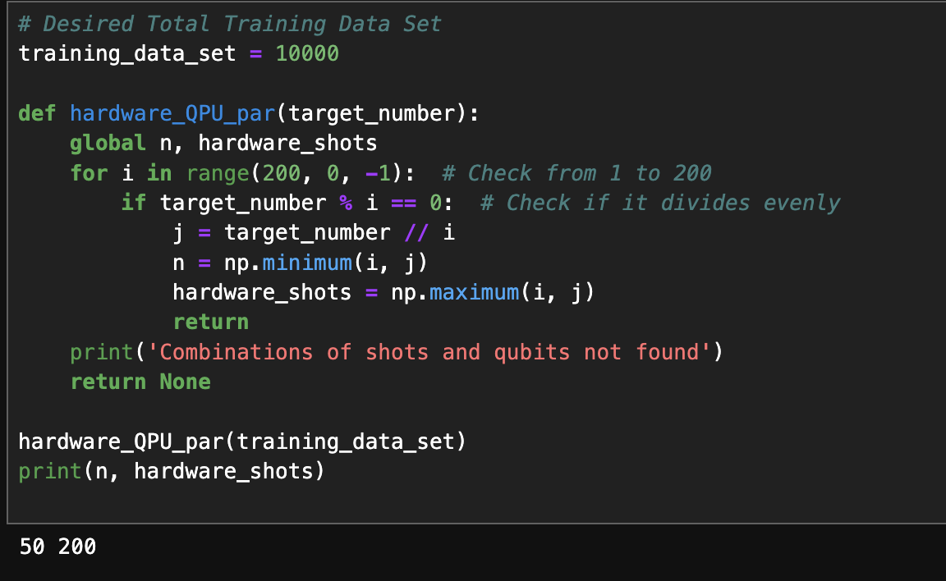
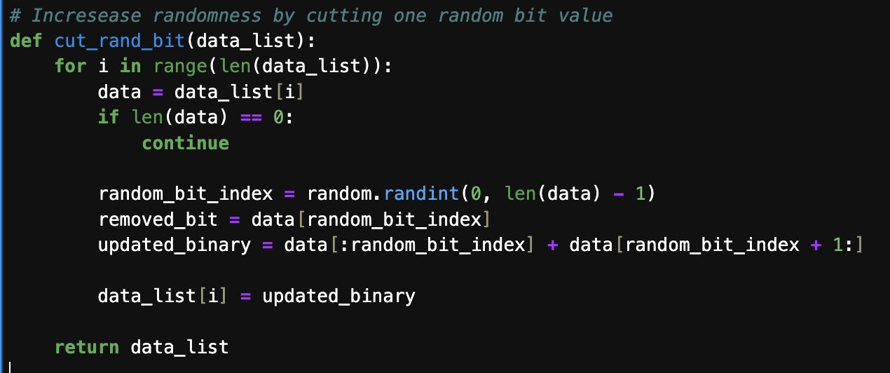
Stage 4 - Pre-processing for High Entropy
Enhanced Stage 1 Algorithm
Notes:
Pre-processing technique:
Quantum Error Correction: https://github.com/qiskit-community/qgss-2024/blob/main/labs/lab3/lab3.ipynb
Post-processing technique:
https://github.com/GehadSalemFekry/qrng/blob/main/pre-post-processing.py
https://github.com/qiskit-community/qiskit_rng/tree/master
https://docs.quantum.ibm.com/api/qiskit/0.28/qiskit.providers.ibmq.random.CQCExtractor

Slide 21
Stage 4 - Post-processing for High Entropy
Toeplitz Matrix
Getting more entropy RNG is possible by (bitwise) multiplying the matrix of random bits by a randomly seed Toeplitz matrix.
NIST randomness tests: Frequency Test within a Block and Monobit tests
Monobit: (1000 trials of QRNG)
100% failure probability
Freq Test: (1000 trials of QRNG)
100% success probability

Slide 22
Stage 4 - Post-processing for High Entropy
QRNG’d 100 Bit String (avg. over 1000 trials)
Min-entropy | 0.8959892302251026
Max-entropy | 0.9931296313434375
PRNG’d 100 Bit String (avg. over 1000 trials)
Min-entropy | 0.8918179682908735
Max-entropy | 0.9920298787692892
Notes:
Pre-processing technique:
Quantum Error Correction: https://github.com/qiskit-community/qgss-2024/blob/main/labs/lab3/lab3.ipynb
Post-processing technique:
https://github.com/GehadSalemFekry/qrng/blob/main/pre-post-processing.py
https://github.com/qiskit-community/qiskit_rng/tree/master
https://docs.quantum.ibm.com/api/qiskit/0.28/qiskit.providers.ibmq.random.CQCExtractor

Slide 23
Stage 4 -
BB84
q_0: ──────────
┌───┐
q_1: ┤ H ├─────
├───┤┌───┐
q_2: ┤ H ├┤ H ├
├───┤└───┘
q_3: ┤ H ├─────
└───┘
q_4: ──────────
q_5: ──────────
┌───┐
q_6: ┤ H ├─────
└───┘
q_7: ──────────
The BB84 algorithm is a quantum key exchange algorithm that prevents eavesdropping through secret communication and Hadamard gates.

Slide 24
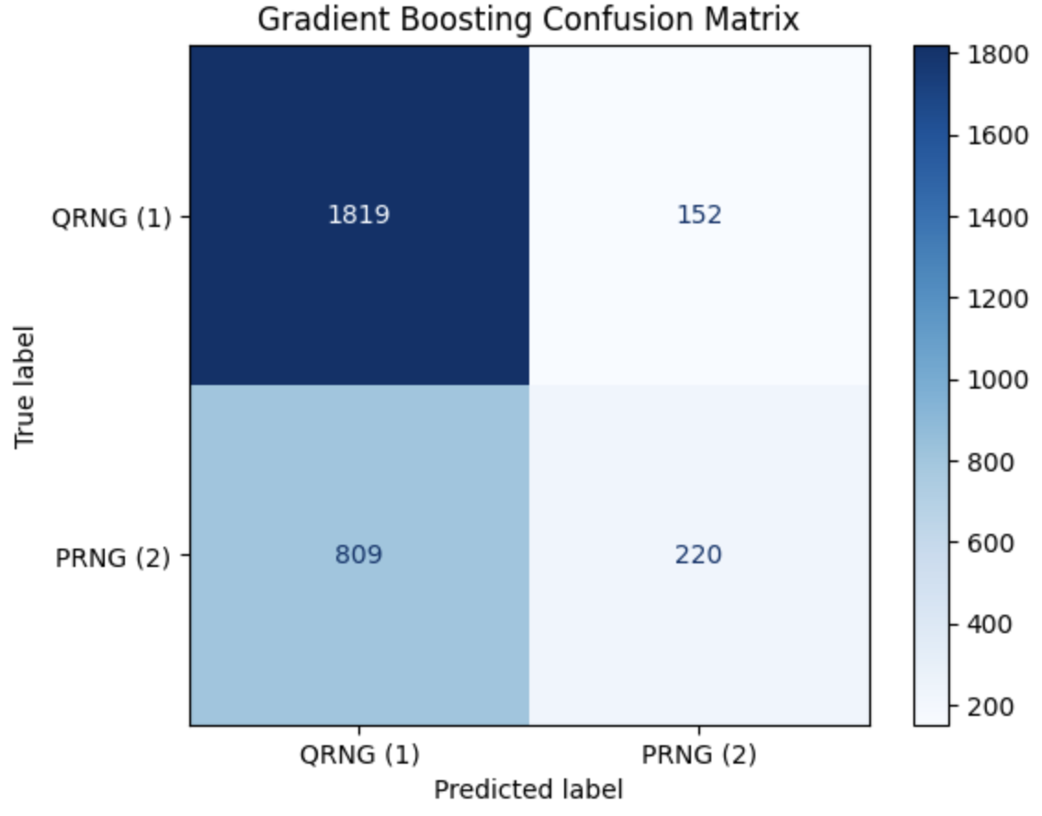
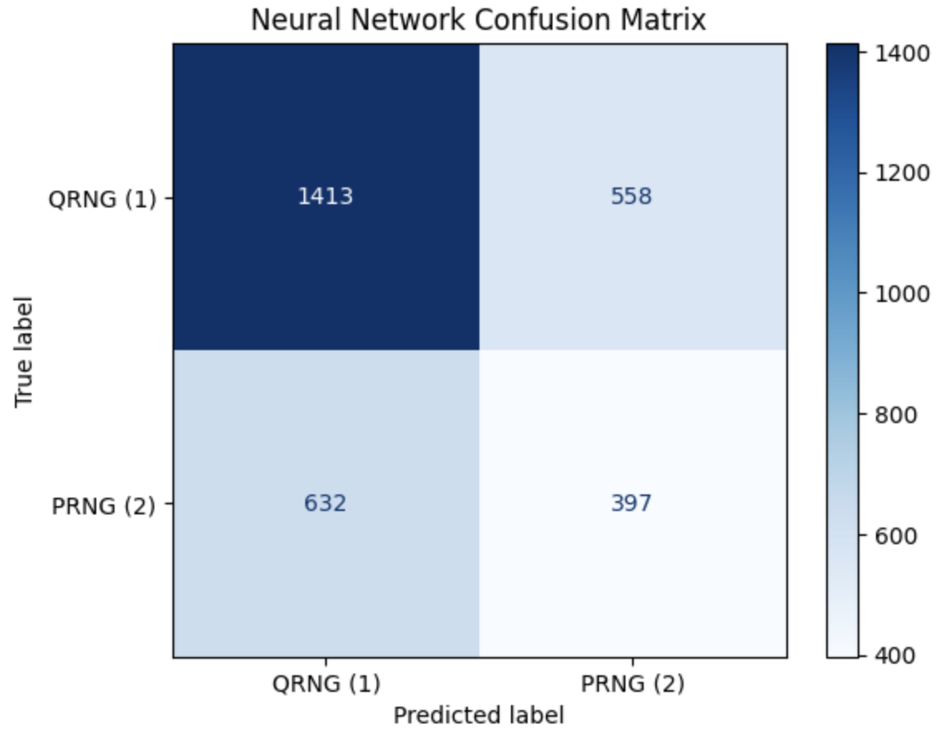
Stage 5 - High-Accuracy Classification Models for QRNG Verification
The accuracy of Gradient Boosting and MLP decreased significantly to 67.97% and 60.03%, respectively, after adding more quantum data from stage 4. The new dataset consists of 10,000 samples from QRNG and 10,000 samples from PRNG, maintaining the same training and test set ratio.
Confusion matrix of Gradient Boosting and MLP on test set after adding data

